Slide 1
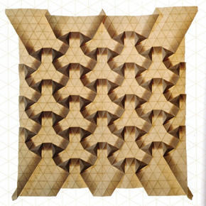
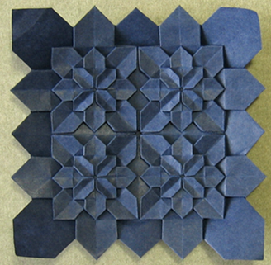
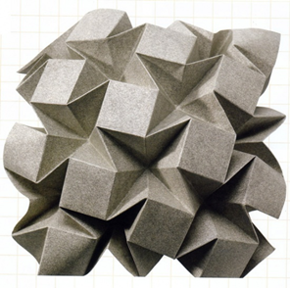
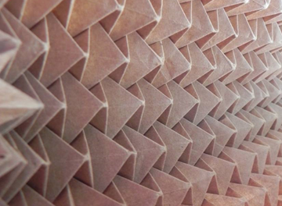
Origami Robots
By
Tej Patel
www.tejorigami.com
Notes:
Hi ! I am Tej Patel. I am origami enthusiast.

Slide 2
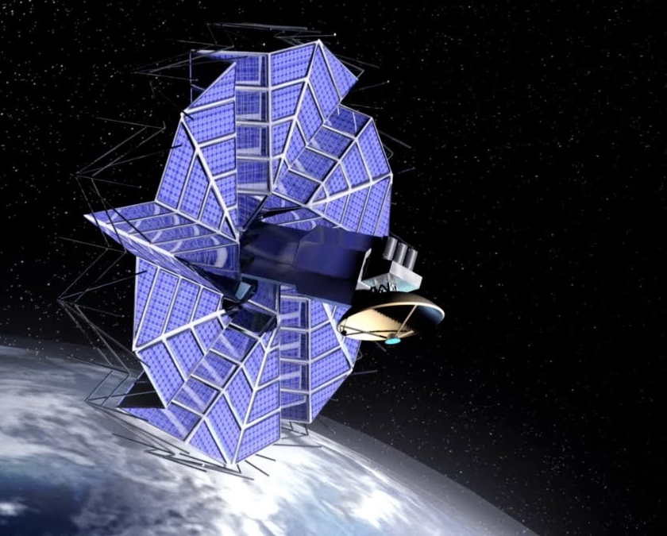
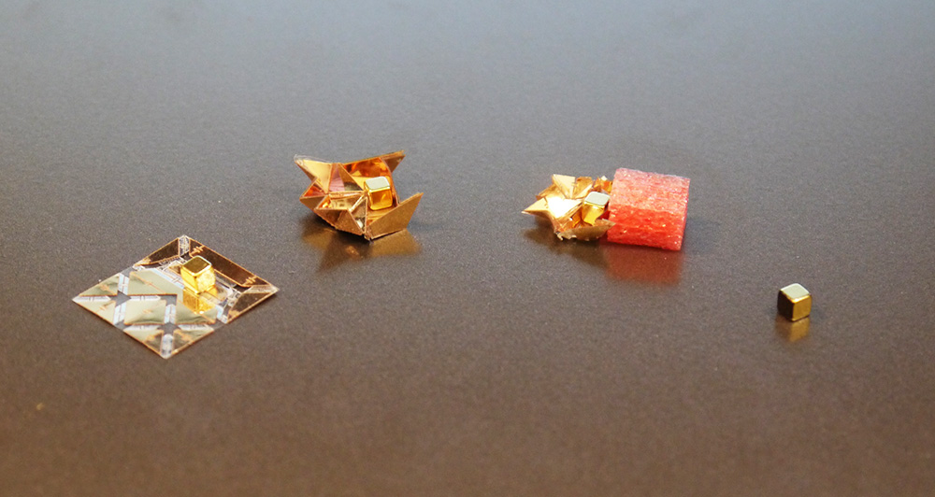
Origami Robots
Did you know in Solar Panels in compact satellites are folded using Origami patterns so they can get maximum surface area once they open. Same concepts are used to create small foldable robots for novel medical devices like stent
Notes:
Origami have been used from Aeronautical Science to Medical Science. Origami is inspiring cutting age technology. It has application in many fields.

Slide 3
Index
Let’s get to know – Contents in the kit
Introduction to Origami
Applications of Origami
Learning folds in Origami
Adding Digital Fabrication to Origami
Making Origami Robot
Notes:
I will follow this sequence to make this session easy and full of fun.

Slide 4
Let’s get to know!
Contents
Origami Papers
Scale
Pencil
Servo Motor
Servo Tester
3D Printed Stand
Screw Driver
Needle - Thread
Cotton Earbud
Two way tape
Battery 9 volt
Cellotape
Notes:
Let’s get to know the materials we will be using for making a Origami SnailBot or Robot. Now let me introduce a bit about Origami.

Slide 5
Origami
Origami, (pronounced or-i-GA-me) is the Japanese art of paper folding.
“Ori” (root verb "oru") is the Japanese word for folding
and
“kami” is the Japanese word for paper
Notes:
Origami is form of sculpture that is created by folding paper.

Slide 6
Pure Origami
The rules of Pure origami are as follows:
1. Starting with a square piece of paper
2. DO NOT use glue, tape, or scissors
3. DO NOT decorate the model after it is complete
Notes:
To put it in simple words we can say that in Origami We start with a single sheet of paper and without adding or subtracting anything we make a sculpture.

Slide 7

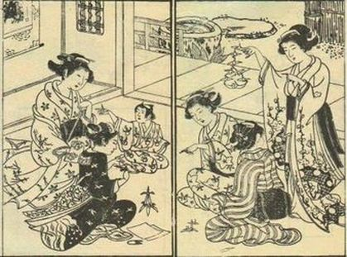
Origin of Origami
The Chinese invented paper in 100 A.D.
The invention of paper spread to Japan in 600 A.D., so did the art of folding it
Notes:
The most important resource for Origami is paper. There are many different kind of papers having many unique properties are used.
It is in 600 AD Origami started.

Slide 8
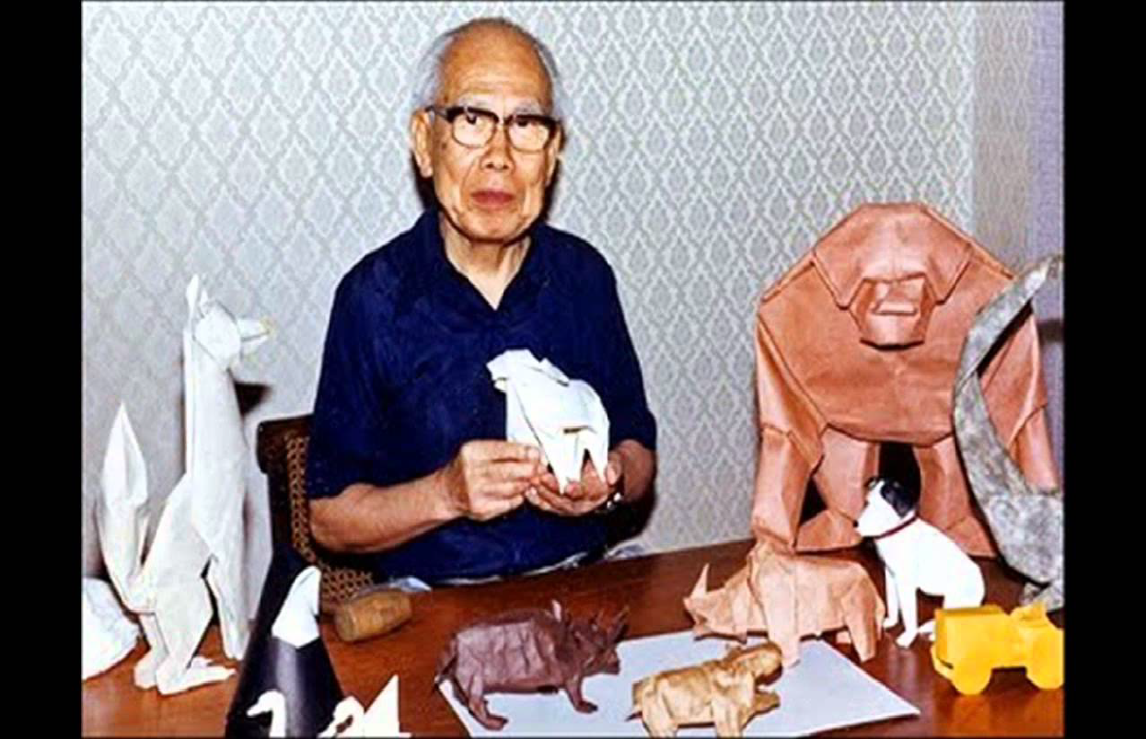
Grand Master of Origami
AKIRA YOSHIZAWA has designed more than 50000 models and wrote 18 books on Origami, and most importantly, he gave a Language for Origami
Notes:
He also created notation for origami folds : a system of symbols, arrow, and diagrams. He is credited with raising origami from a craft to a living art.
He has come up with more than 50000 models in his lifetime. He also wrote 18 books on Origami.

Slide 9
Types of Origami
Action
Modular
Wet Folding
Tessellations
Pureland
Strip Folding
Notes:
There are many other types of Origami as well. Like Giant Origami, Money(Dollor) Origami, Fractals Origami, Miniature Origami, Infinite Origami, Jewelry Origami, Metal Origami, Fabric Origami, Towel Origami etc.

Slide 10
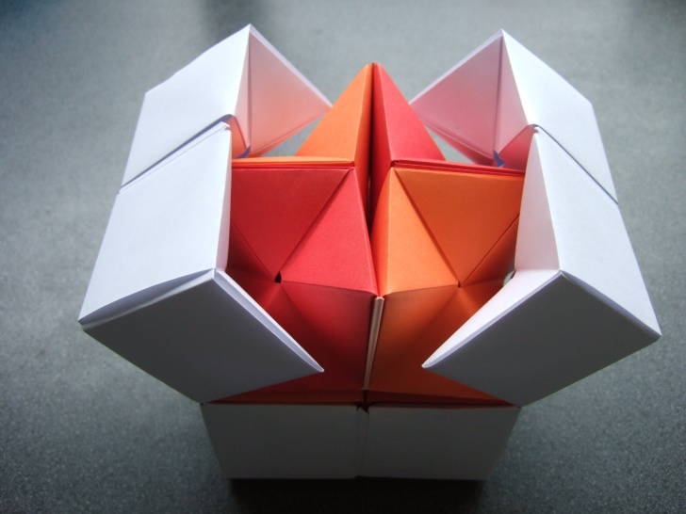
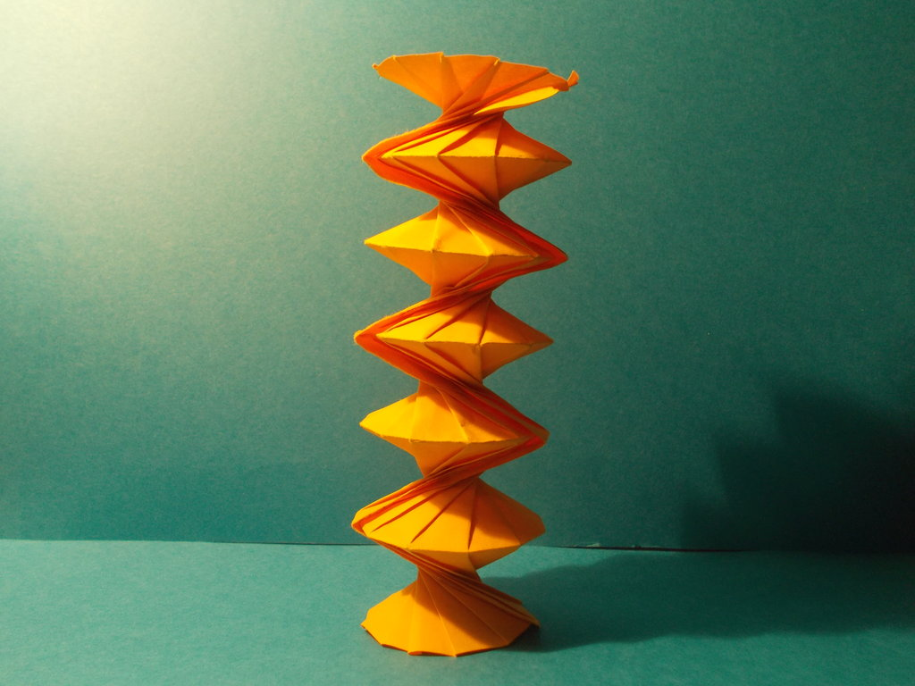
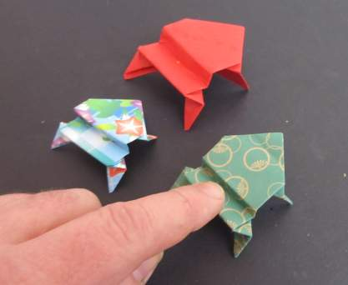
Action Origami
Action : The folded model includes some movement such as jumping, flapping, flying, etc
Notes:
I have few models of Action Origami to see what can a paper can do !!!

Slide 11
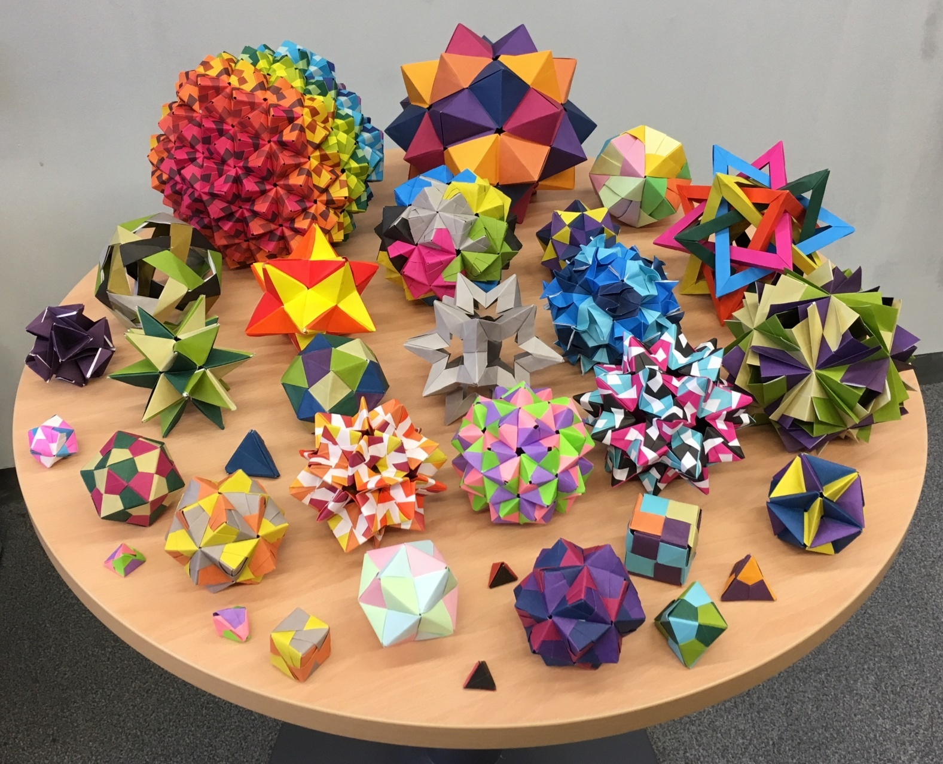
Modular Origami
Modular (Unit) : More than one unit is used to make it. They are assembled without using glue
Notes:
Today we are going to make one Modular Origami model.

Slide 12

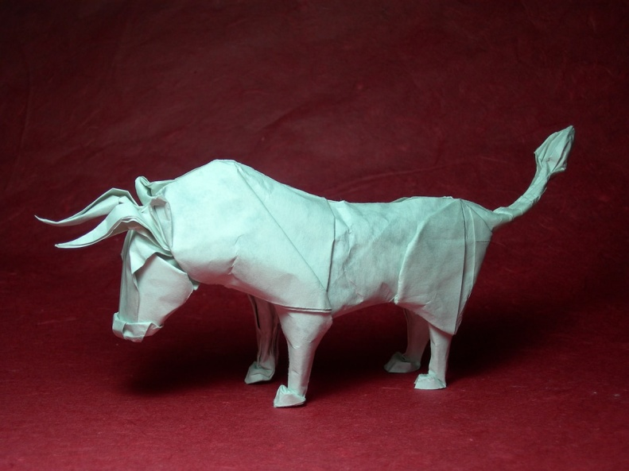
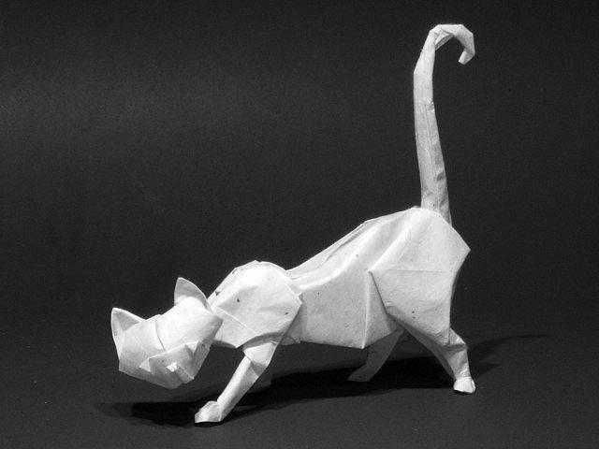
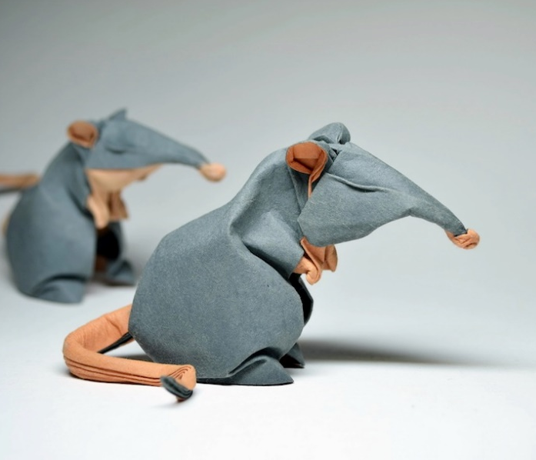
Wet Fold Origami
Wet-Folding : Water is applied to the finished model. When the paper dries, it holds whatever shape you have imparted to it
Notes:
This type of Origami was pioneered by Grand master Akira Yoshizawa.This is how you can add emotions to the paper.

Slide 13
Tessellations Origami
Tessellations : Origami tessellations (also called tiling) are repeating geometric patterns folded from a single piece of paper
Notes:
Tessellations is where Origami meets Mathematics.

Slide 14
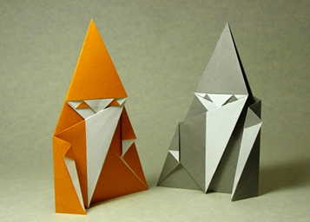

Pureland Origami
Pureland : There are only two types of fold (Mountain and Valley Folds) used in this category. Land in the Pureland word refers to the real world which has mountains and valleys
Notes:
The aim of pureland origami is to make origami easier for inexperienced folders. It is also beneficial to those who have impaired motor skills.

Slide 15

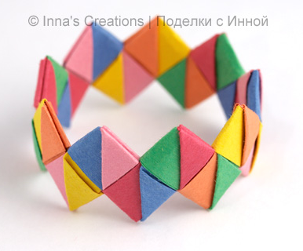
Stripfolding Origami
Strip Folding: Strip folding is a combination of paper folding and paper weaving

Slide 16
Applications of Origami
Space
Medicine
Automobile
Artificial Robot Muscle
Furniture Design
Architectural Design

Slide 17
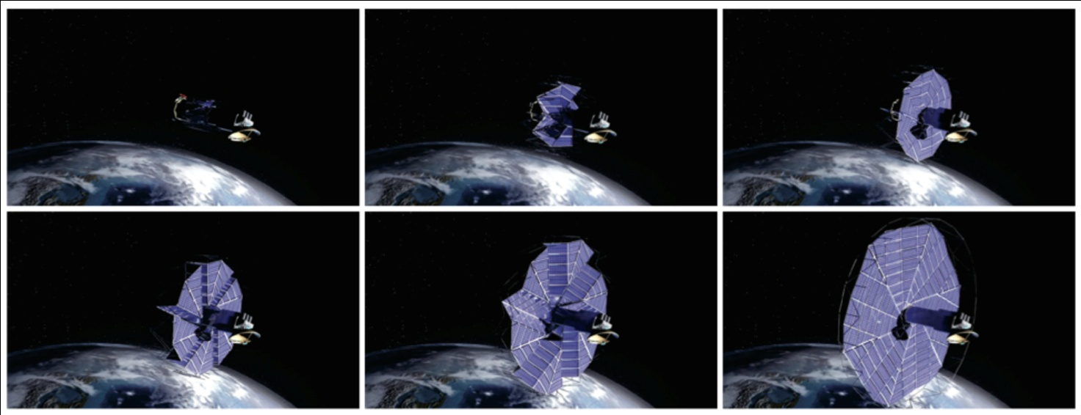
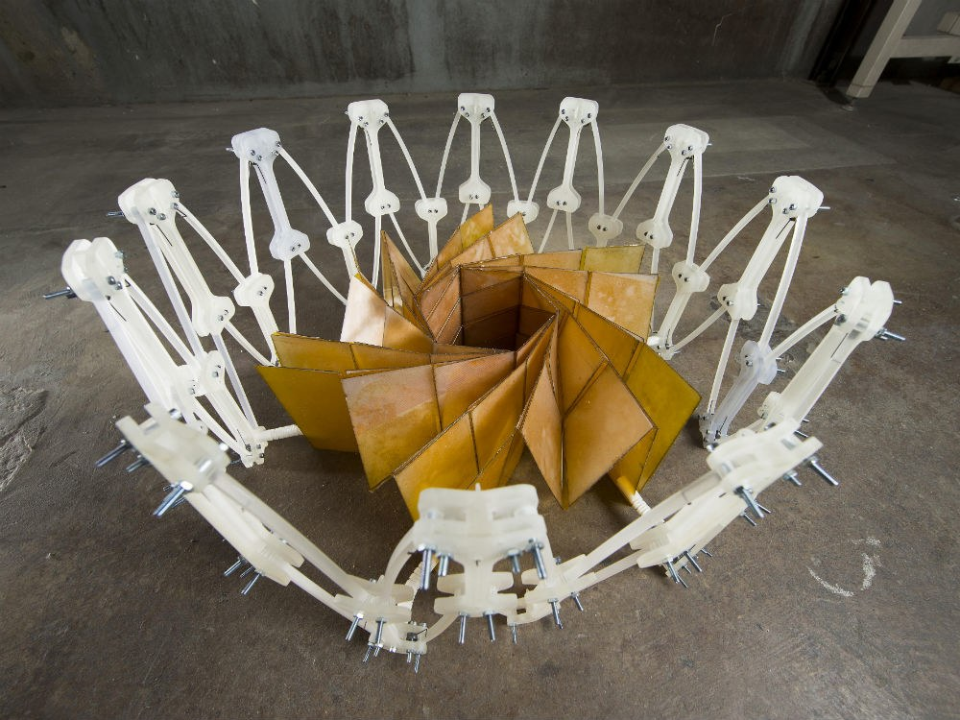
Space
To accommodate in the less space in satellite, the solar panel has to be sent in a folded form inspired by Origami
Notes:
Anything that is too big to be stored or transported in compact space. Origami can always be thought of. Rocket space is too little (5 meter diameter) : Solar panel is huge - solution is origami folding.

Slide 18
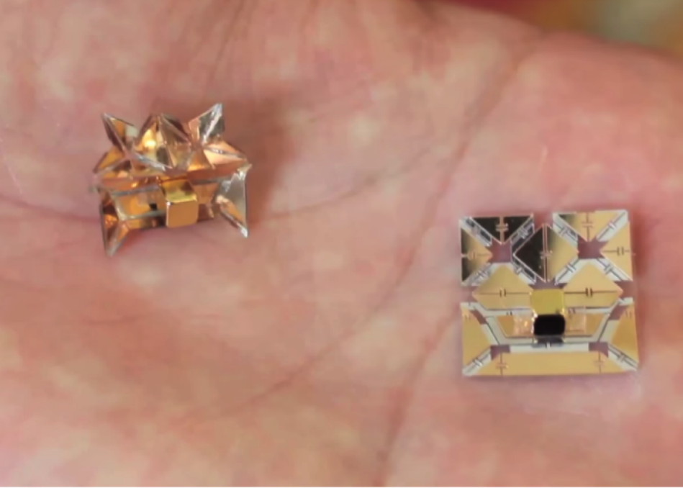
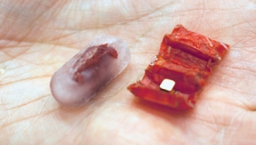
Medicine
Tiny origami robot that can unfold itself which is swallowed in capsule can made crawl to specific location in the body for various medical procedure
Notes:
1. Origami robot is placed inside capsule. 2. Capsule is swallowed in human body. 3. Robot crawl to specific place inside body. 4. Robot does the required medical procedure.

Slide 19
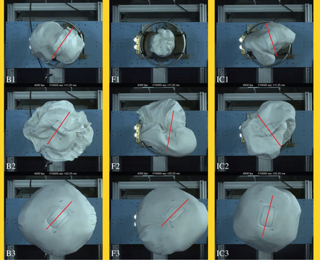
Automobile
Origami technique is used in air bag where the airbag should be inflated in milliseconds and also fit in compact place when not in use. It also helps in proper cushioning during high speed impact
Notes:
1. Airbag required to be stored in compact place. 2. Origami folding helps the airbag to inflate in milliseconds. 3. Also help for proper cushioning during high speed impact - save lives.

Slide 20
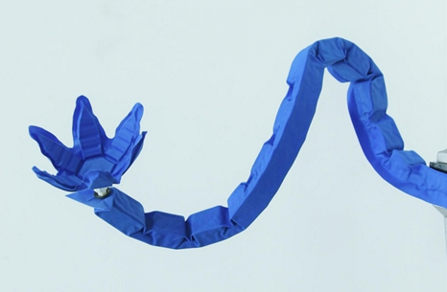
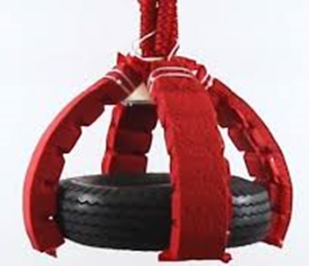
Artificial Robot Muscle
Artificial muscle with the help of origami design can lift up to a thousand times its own weight. The muscles could be used to provide extraordinary strength to robots, yet allowing them to operate with precision. It uses law of contraction and expansion
Notes:
1. Origami fold helps to lift up to a 1000 times weight. 2. It gives extraordinary strength to robots with precision. 3. Muscle works on the law of..

Slide 21


Furniture Design
Origami can add value to Furniture design in beauty, uniqueness, space management and comfort
Notes:
1. It gives many new ideas in Furniture design. 2. Great for space management. 3. It gives beauty and uniqueness as you can see on slide.

Slide 22
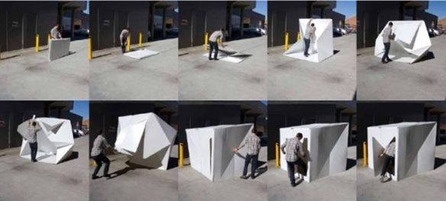
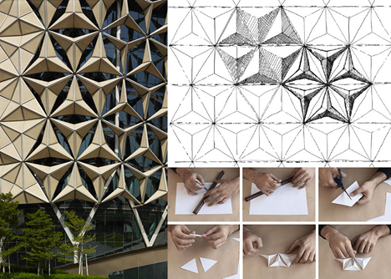
Architectural Design
Portable compact shelter for emergencies & disaster : light & fast.
Origami based facade is used to control light and temperature. There are many application in Interior design as well
Notes:
1. Origami folded compact shelter is portable. 2. Absolutely perfect for emergencies & disaster. 3. Lightweight and fast to install make is perfect application.
1. Outer walls of building can also be inspired by Origami. 2. It helps control light and temperature. 3. Many other applications in Interior design as well.

Slide 23
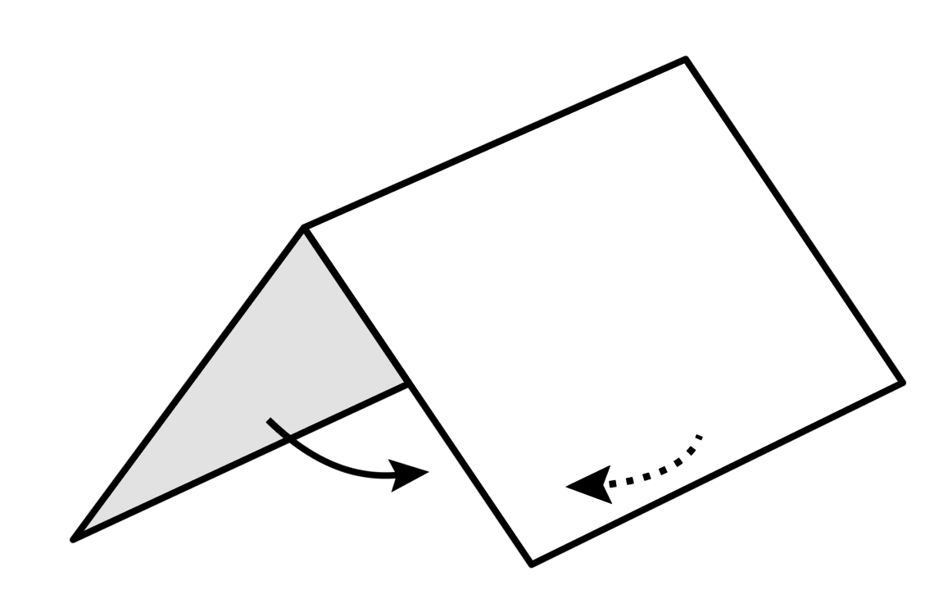
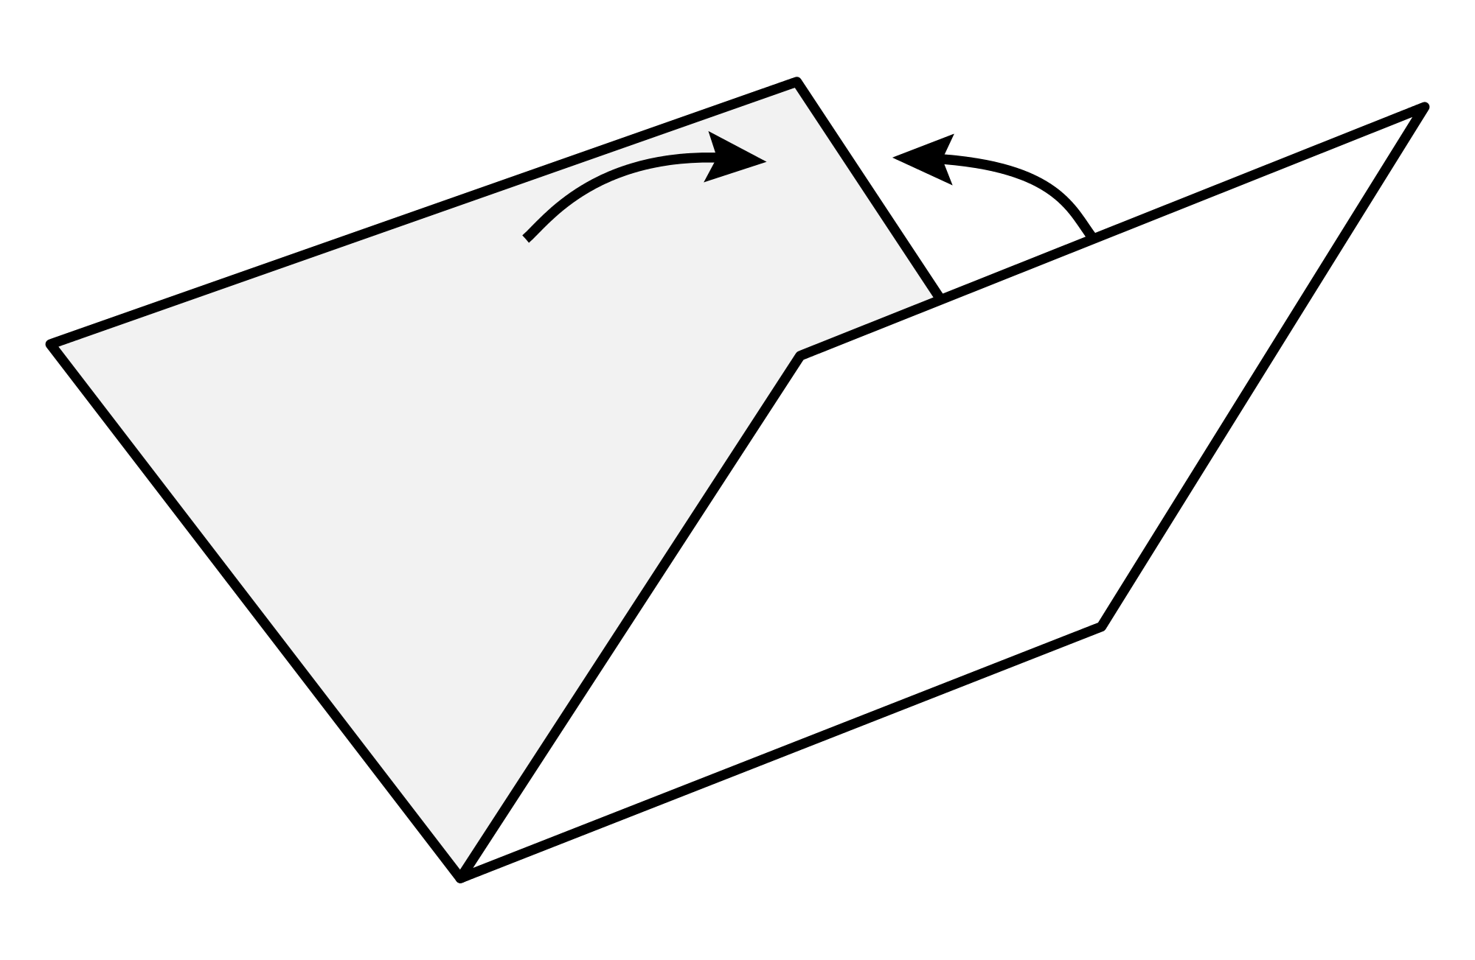
Learning Folds
Mountain Fold
Valley Fold
Notes:
Origami has two major folds mountain and valley fold.

Slide 24
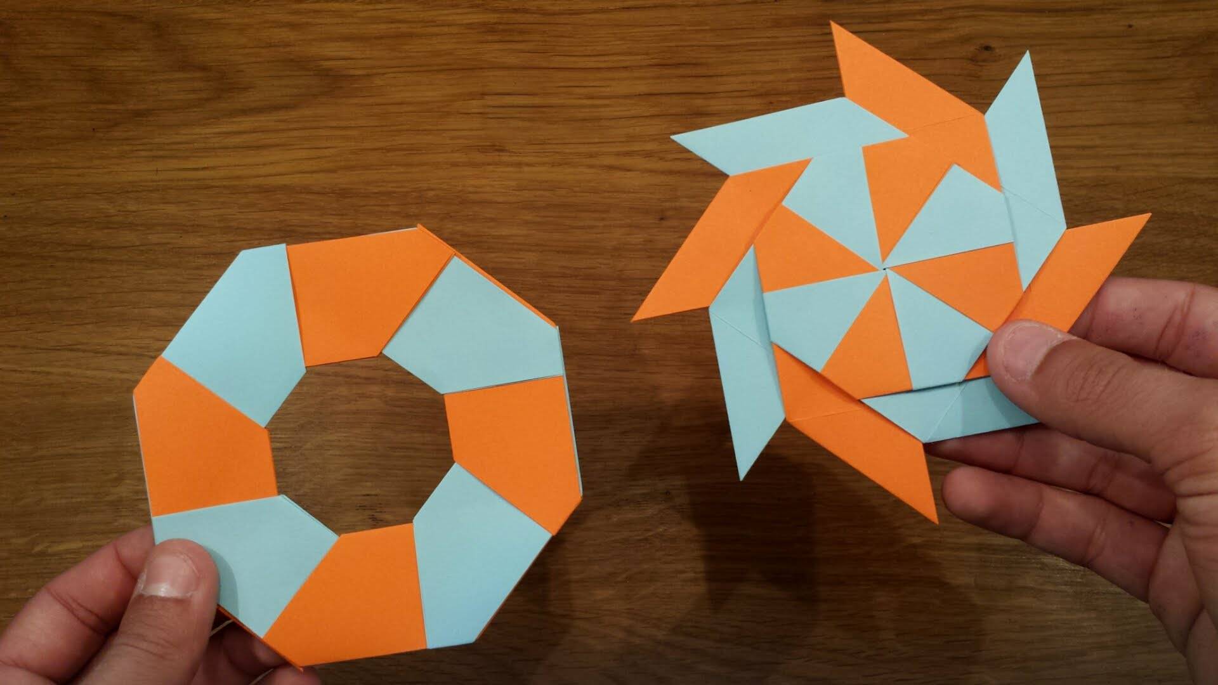
Let’s Make Origami Transforming Ninja Star
Notes:
https://www.youtube.com/watch?v=mpATXLAX_SU

Slide 25
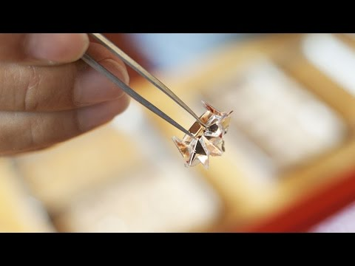
Digital Fabrication & Origami
Notes:
https://www.youtube.com/watch?v=mpATXLAX_SU

Slide 26
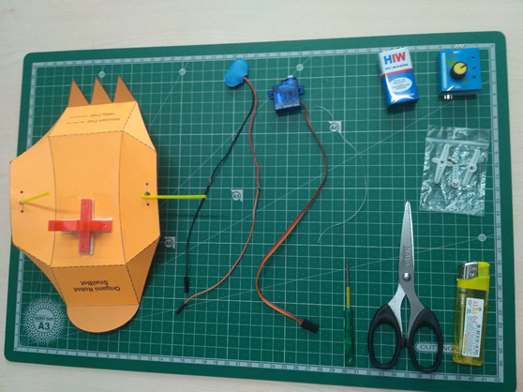
Let’s Make Origami Robot
Notes:
https://www.youtube.com/watch?v=mpATXLAX_SU

Slide 27
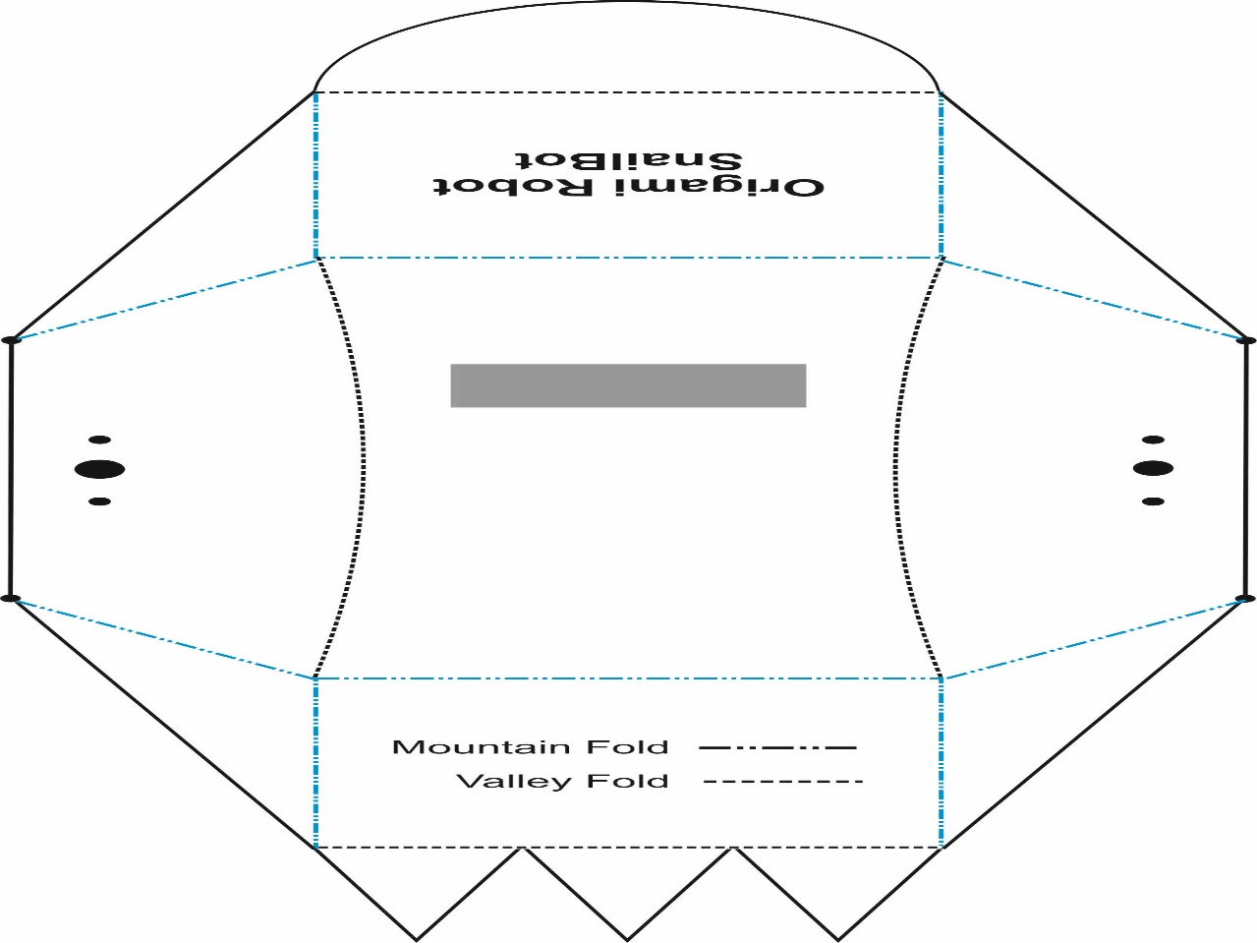
Mountain Folds
Notes:
https://www.youtube.com/watch?v=mpATXLAX_SU

Slide 28
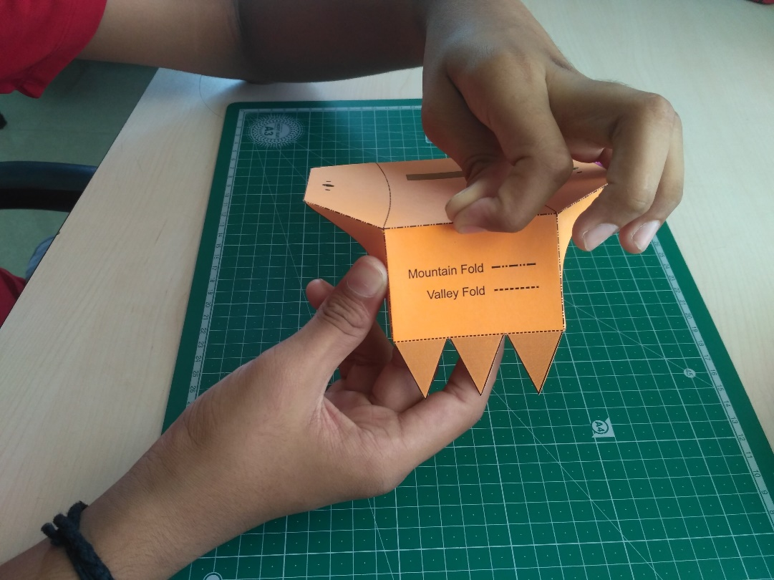
Mountain Folds
Notes:
https://www.youtube.com/watch?v=mpATXLAX_SU

Slide 29
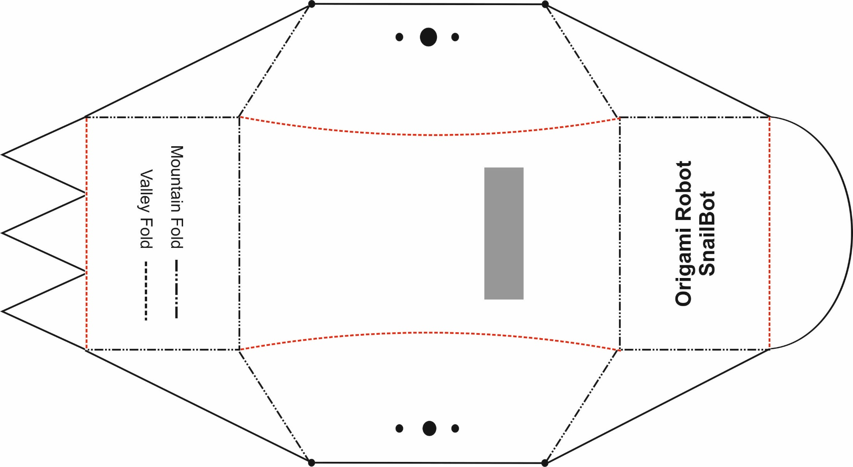
Valley Folds
Notes:
https://www.youtube.com/watch?v=mpATXLAX_SU

Slide 30
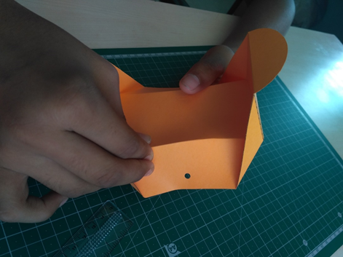
Valley Folds
Notes:
https://www.youtube.com/watch?v=mpATXLAX_SU

Slide 31
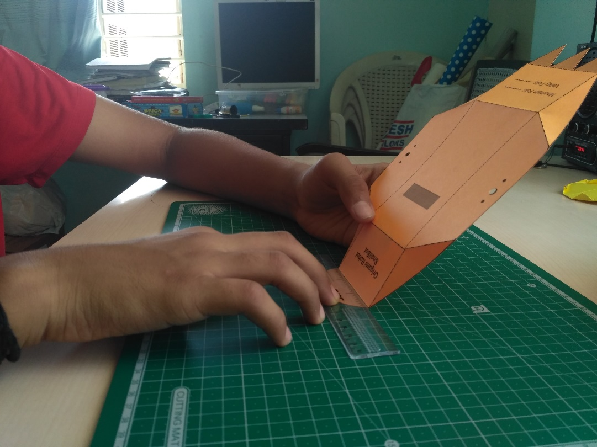
Valley Folds
Notes:
https://www.youtube.com/watch?v=mpATXLAX_SU

Slide 32
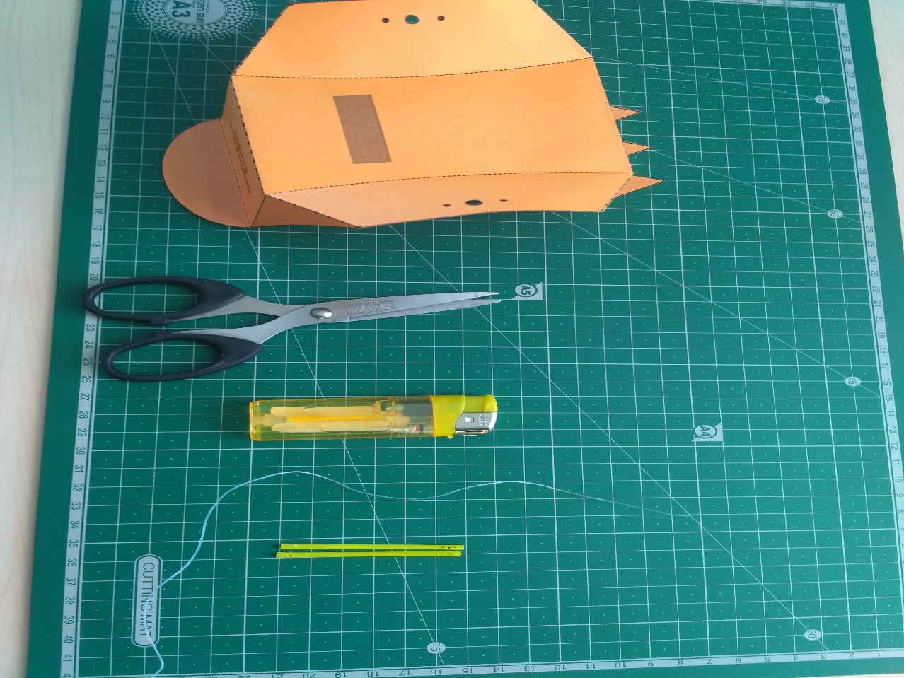
Let’s add Some Mechanism
Notes:
https://www.youtube.com/watch?v=mpATXLAX_SU

Slide 33
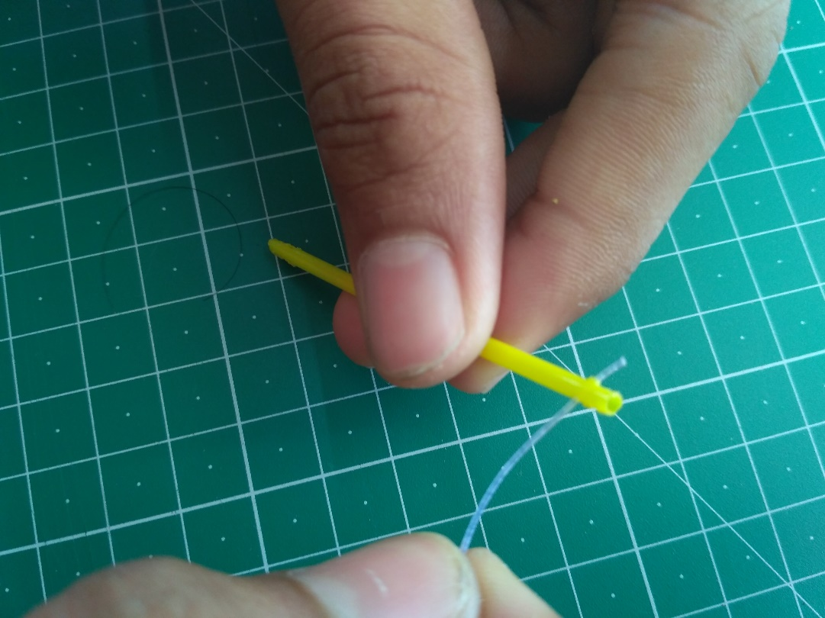
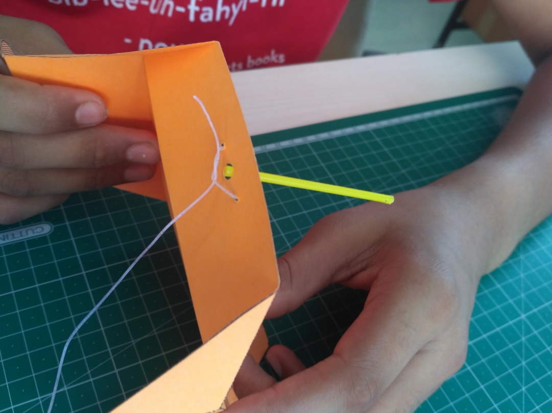
Nylon Thread to Ear Bud
Notes:
https://www.youtube.com/watch?v=mpATXLAX_SU

Slide 34
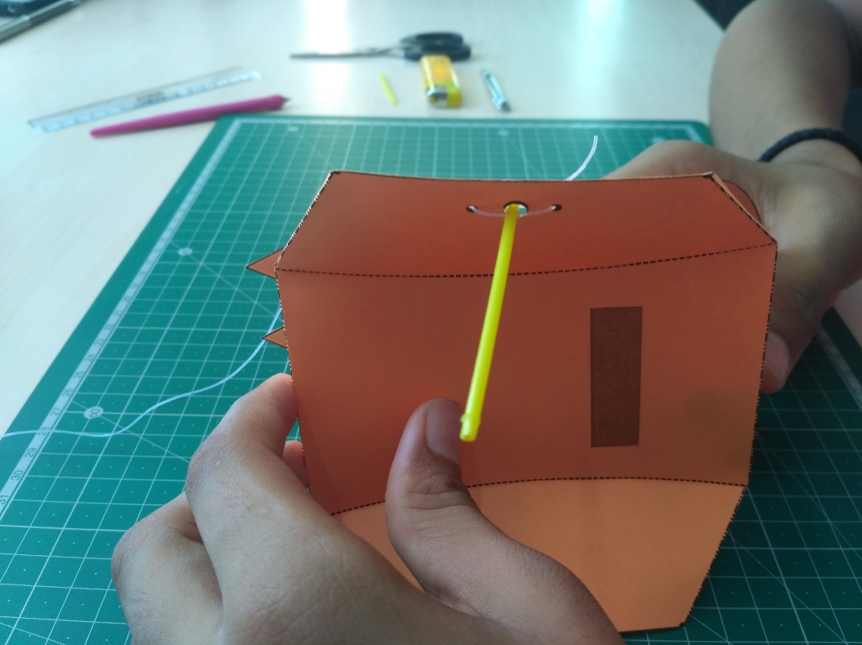
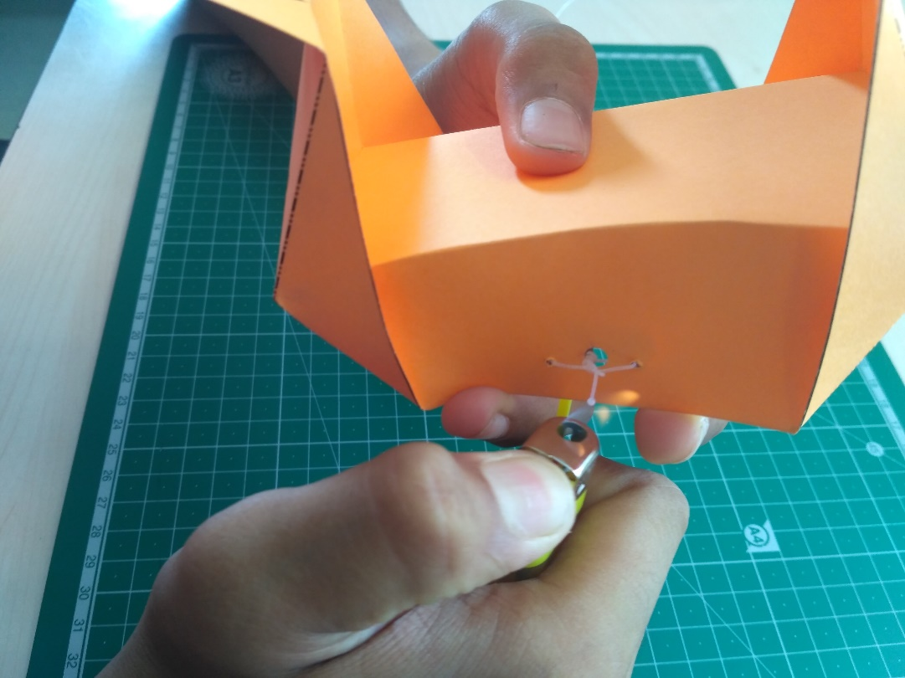
Sealing Nylon thread with Lighter
Notes:
https://www.youtube.com/watch?v=mpATXLAX_SU

Slide 35
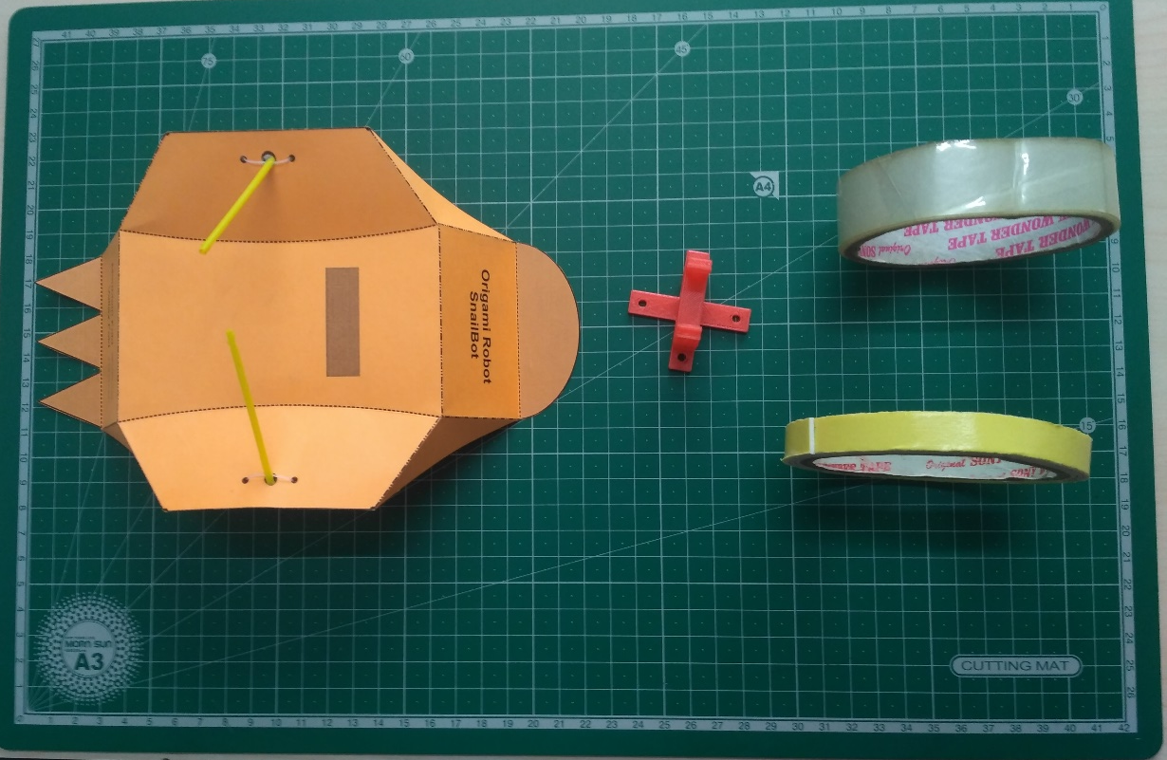
Mounting 3D Printed Stand
Notes:
https://www.youtube.com/watch?v=mpATXLAX_SU

Slide 36
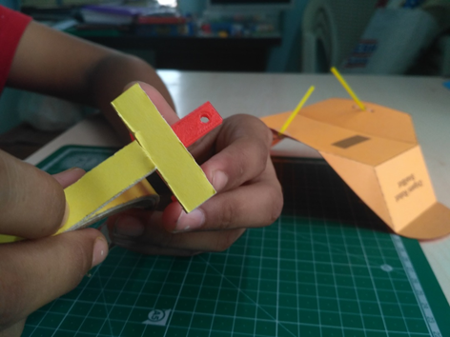
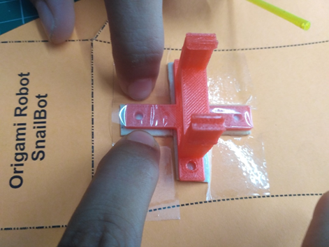
Sticking 3D Printed Stand
Notes:
https://www.youtube.com/watch?v=mpATXLAX_SU

Slide 37
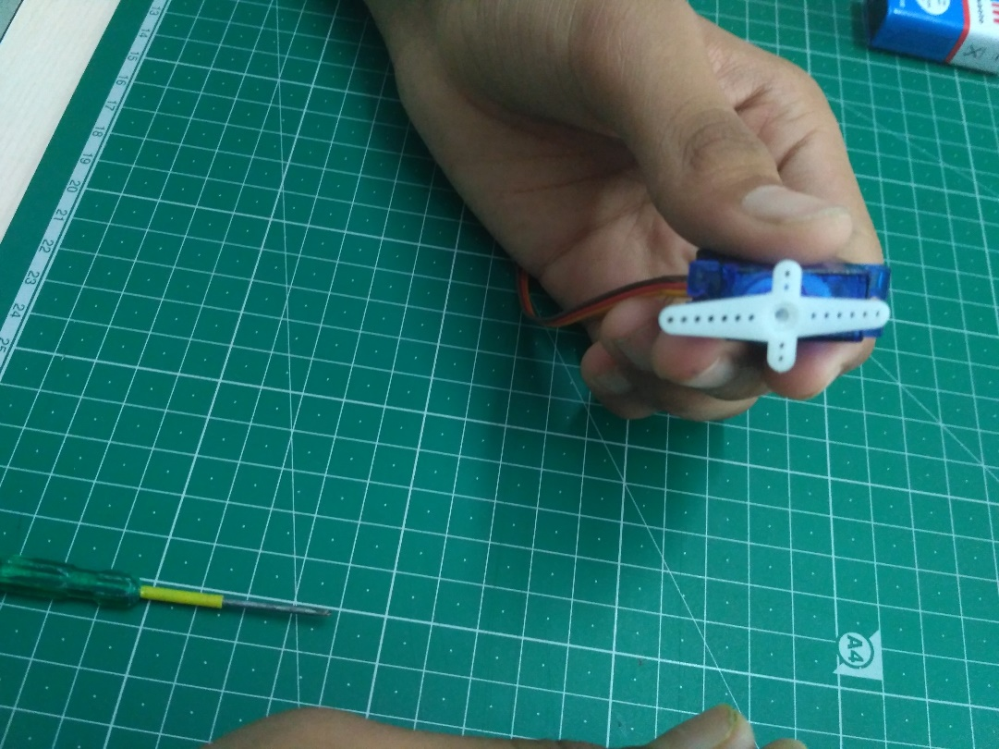
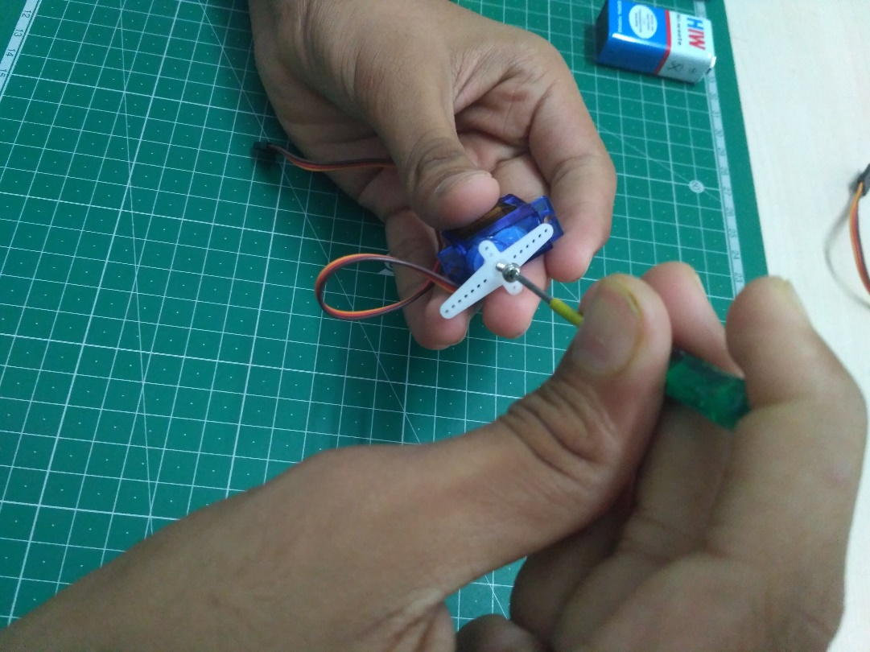
Setting Servo to Zero Degree
Notes:
https://www.youtube.com/watch?v=mpATXLAX_SU

Slide 38
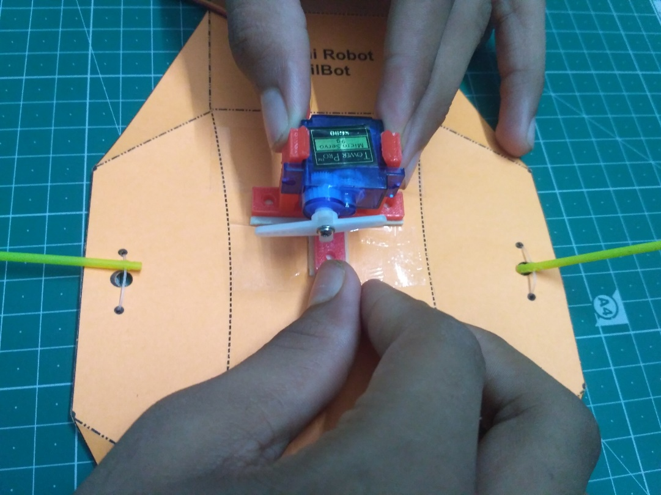
Press-Fit Servo to stand
Notes:
https://www.youtube.com/watch?v=mpATXLAX_SU

Slide 39
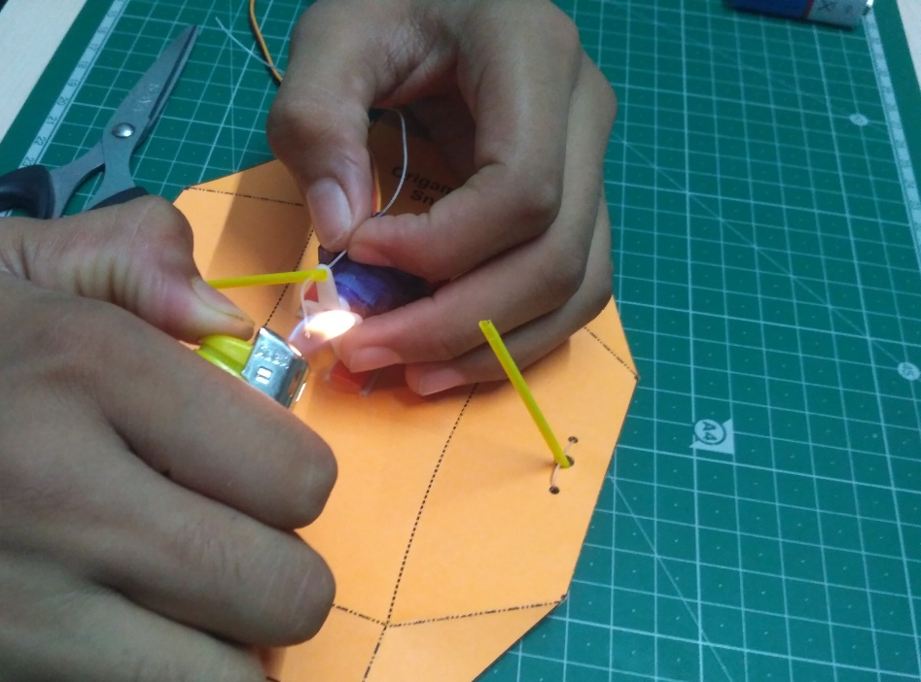
Connecting pipe to the arm of Servo Motor.
Notes:
https://www.youtube.com/watch?v=mpATXLAX_SU

Slide 40
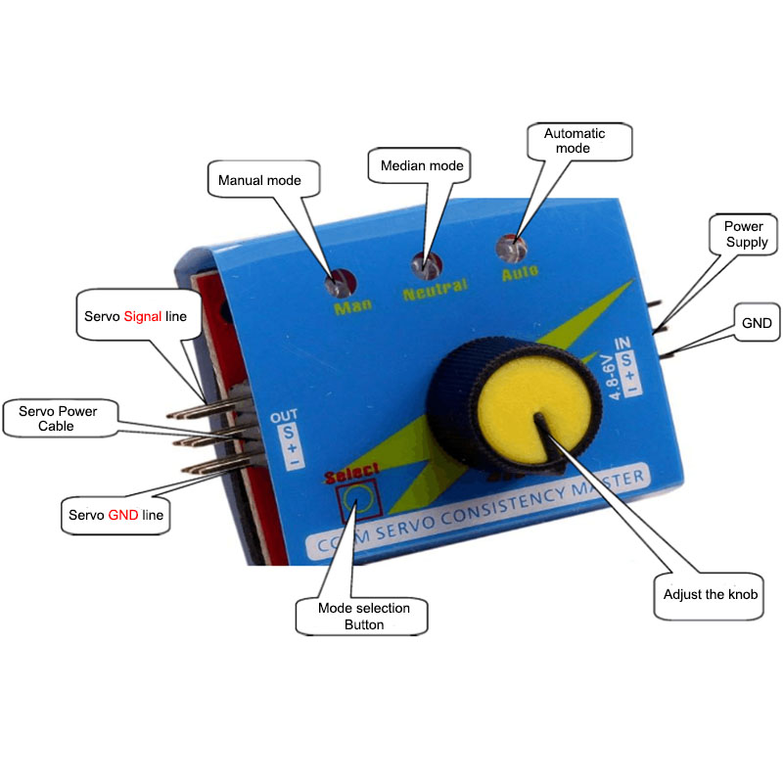
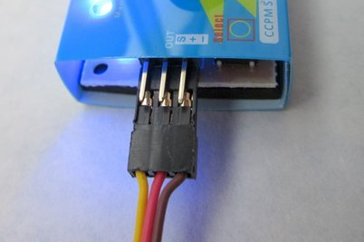
Servo Tester
Notes:
https://www.youtube.com/watch?v=mpATXLAX_SU

Slide 41



Connections
Servo Tester
Tower Pro SG90
9 Volt Power Input
Notes:
https://www.youtube.com/watch?v=mpATXLAX_SU

Slide 42

Origami SnailBot is Ready
Notes:
https://www.youtube.com/watch?v=mpATXLAX_SU

Slide 43
Resources
Websites:
https://origamiusa.org/resources
https://www.origami-resource-center.com/
https://www.happyfolding.com/
https://www.giladorigami.com/origami-links.html
YouTube Channels:
https://www.youtube.com/jonakashima
https://www.youtube.com/jeremyshaferorigami
https://www.youtube.com/AdamsSara
https://www.youtube.com/channel/UCbEiPECXvNKtaa4dUBRUh1w

